Slide 1


Want to WIN a $5 Starbucks Gift Card?
1.Just take a short 10 Question quiz in NFC.
2.Upload your score…
3.Top 3 WIN!

Slide 2
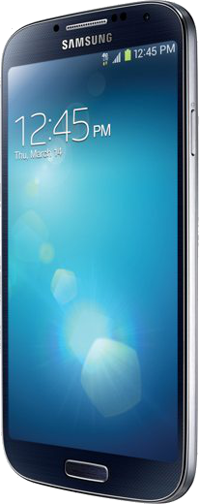
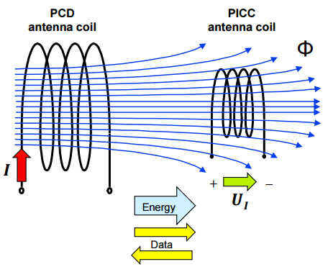

Near Field Communication (NFC) was developed to enable contactless transmission of data. “Near”, in this context is only a few centimeters of space between device and NFC tag. This display focuses on the electromechanical properties of this technology which can transmit a message using an Android device to an NFC tag.
Figure 1 illustrates how a controlled electric current applied to an antenna coil and attached to the powered device actively generates a directed electromagnetic field. NFC technology makes use this phenomenon called electromagnetic induction. The presence/absence of this field over time is used to logically generate a stream of binary data bits.
ISO/IEC 14443 specifies the characteristics of the fields to be provided for power and bi-directional communication between proximity coupling devices (PCDs) and proximity cards or objects (PICCs).
Fig. 1
Smartphone devices that are NFC-enabled operate in “reader/writer” mode, one of three modes defined by the NFC Forum when interfacing with passive NFC tags.
RF interfaces must be compliant in order to generate, transmit, and receive messages on ISO/IEC 18000-3 air interface which describes the parameters for air interface communications at the ISO 14443 standard frequency 13.56 MHz.

